Slide 1
Beat up Motion
Bumping

Slide 2
Let-off Motion
The objective of let-off motion is to maintain the free length of warp within specified limits and to control the warp tension by means of feeding the warp at a correct rate to the weaving zone.
Classification
Let-off motion is classified as negative and positive let-off.
In case of negative let-off, warp is pulled from the warper’s beam against a slipping-friction system.
For positive let-off system, warp beam is rotated through driving mechanism at a controlled rate in order to maintain constant warp tension.

Slide 3
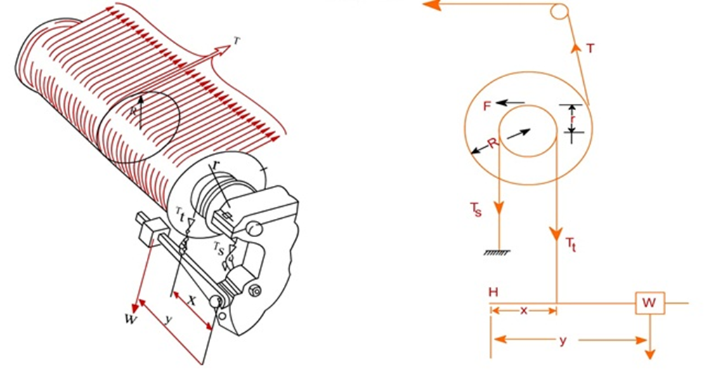
Negative Let-Off

Slide 4
Negative Let-Off
the warp is pulled off the warp beam and warp tension is governed by the friction between chain and the beam ruffle.
The chain makes some wrap over the ruffle. Slack side of the chain is attached with the machine frame whereas the tight side is attached with the weight lever. The lever is fulcrumed at one end with the machine frame. The other end carries dead weights.
Notations:
R = radius of warp on the beam r = beam ruffle radius T_{t} = tension in the chain on tight side (attached with the weight lever) T_{s} = tension in the chain on slack side (attached with machine frame) W= weight x = the distance between fulcrum point and chain on tight side y = the distance between fulcrum point and weight (variable) T = tension in the warp sheet (variable) F = frictional force at the beam ruffle

Slide 6
Equation 5 shows that the condition needed to achieve a constant warp tension is to maintain the ratio constant.
Thus as beam radius R reduces, the distance y must be reduced by moving the weight towards the fulcrum H in regular interval to balance the warp tension.
For example, if the beam radius decreases by 25%, the distance y must be reduced by 25% to maintain a constant warp tension.
Positive Let-off
In case of positive let-off warp, the warp tension is controlled by a mechanism which drives the warp beam at a correct rate.
In most of the positive let-off systems, the backrest is not fixed but floating.
It acts as a warp tension sensing mechanism.
As the tension in the warp increases, the backrest is depressed.

Slide 7
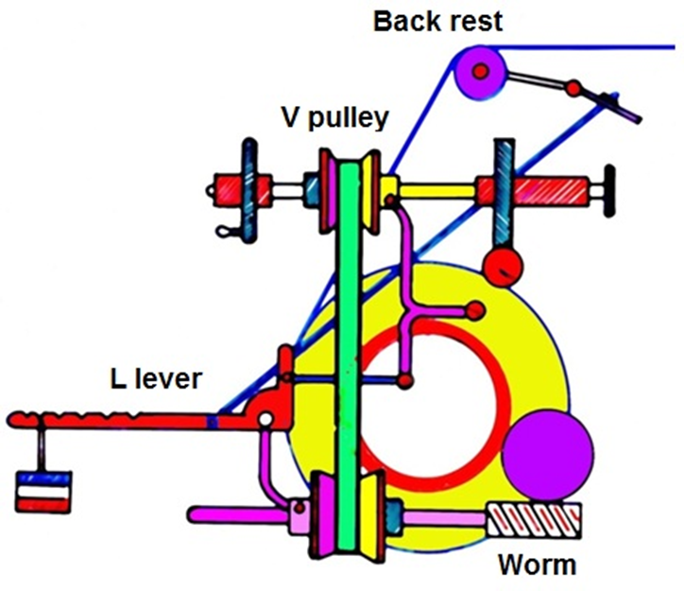
Hunt positive let-off motion
There are two split pullyes made out of V-pulley.
Motion from crank shaft moves the top split pulley via a worm and worm wheel.
Top pulley in turn drives the bottom pulley through a belt.
As the tension on the warp increases the back rest goes down and the L-type lever with weight lowers the diameter of the bottom pulley and essentially increases the diameter of the top pulley through the necessary linkages.
Now the bottom pulley moves at a faster rate than it was earlier and the connecting worm to the beam drive moves more to deliver extra warp in order to reduce the warp tension.

